Slide 1
ASP.NET Core Middleware
What is middleware?
Middleware is software that's assembled into an application pipeline to handle requests and responses.
Each component:
Chooses whether to pass the request to the next component in the pipeline.
Can perform work before and after the next component in the pipeline is invoked.
[works on a concepts of chaining]
Request delegates are used to build the request pipeline. The request delegates handle each HTTP request.
Each middleware component in the request pipeline is responsible for invoking the next component in the pipeline, or short-circuiting the chain if appropriate.

Slide 2
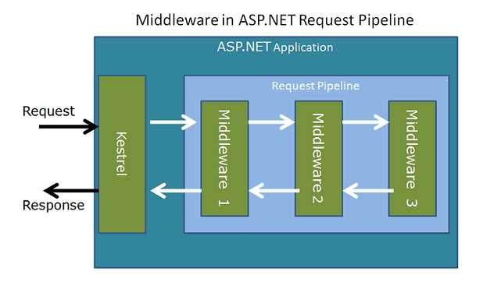

Slide 3
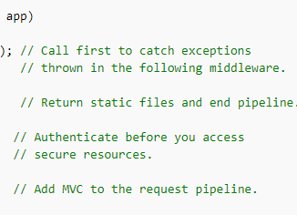
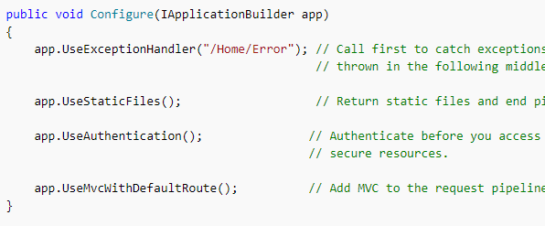
Ordering
The order that middleware components are added in the Configure method defines the order in which they're invoked on requests, and the reverse order for the response. This ordering is critical for security, performance, and functionality.

Slide 4
To understand this let’s write some code now

Slide 5
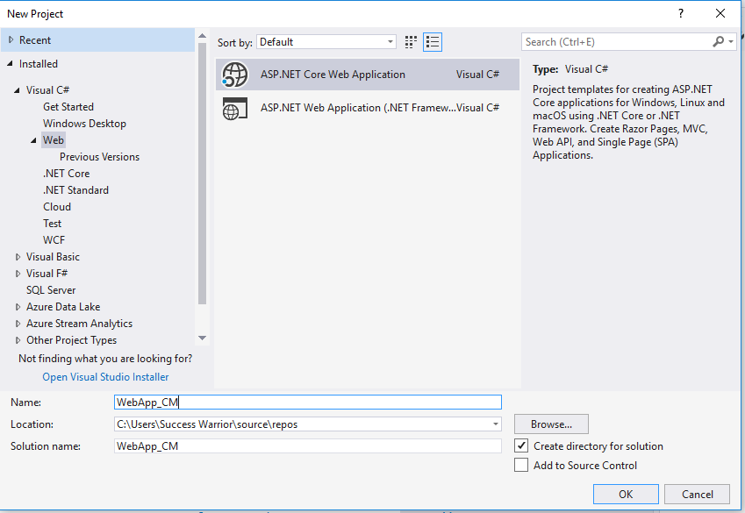

Slide 6
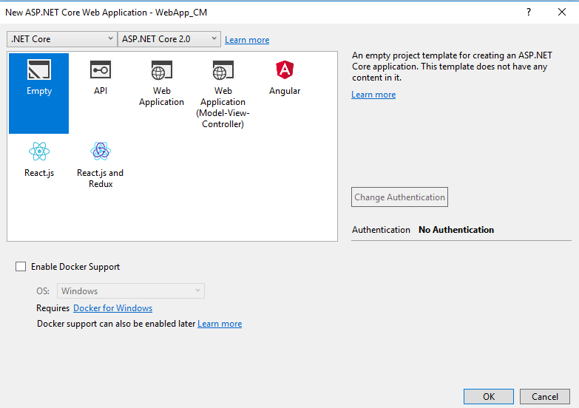

Slide 7
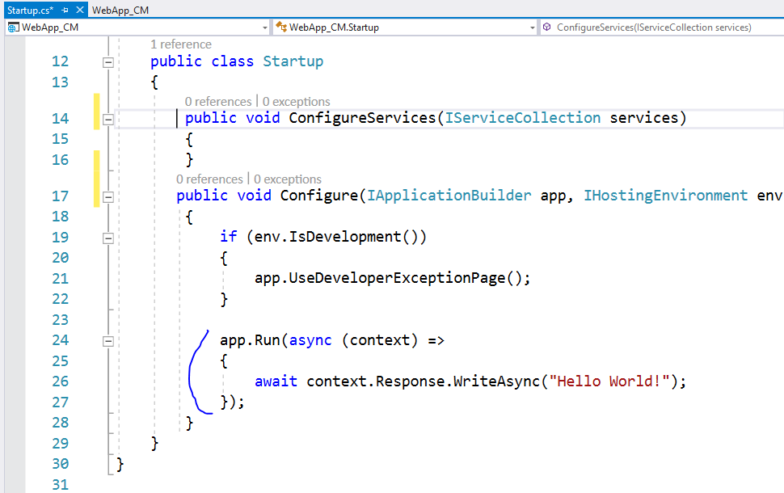
Check this code

Slide 8
We used the app.Run method to register our first middleware, which displays the “Hello world”, when executed.
The app.Run method gets the instance of the Httpcontext. You can use the Responseobject from HttpContext to write out some message to HTTP Response
Just like as we did in Hello World

Slide 9
Configure Middleware with Use and Run
The Use and Run method extensions allow us to register the Inline Middlewares to the Request pipeline
The Run method adds the terminating middleware
The Use method adds the middleware, which may call the next middleware in the pipeline
Now let us add one more middleware using the app.Run

Slide 10
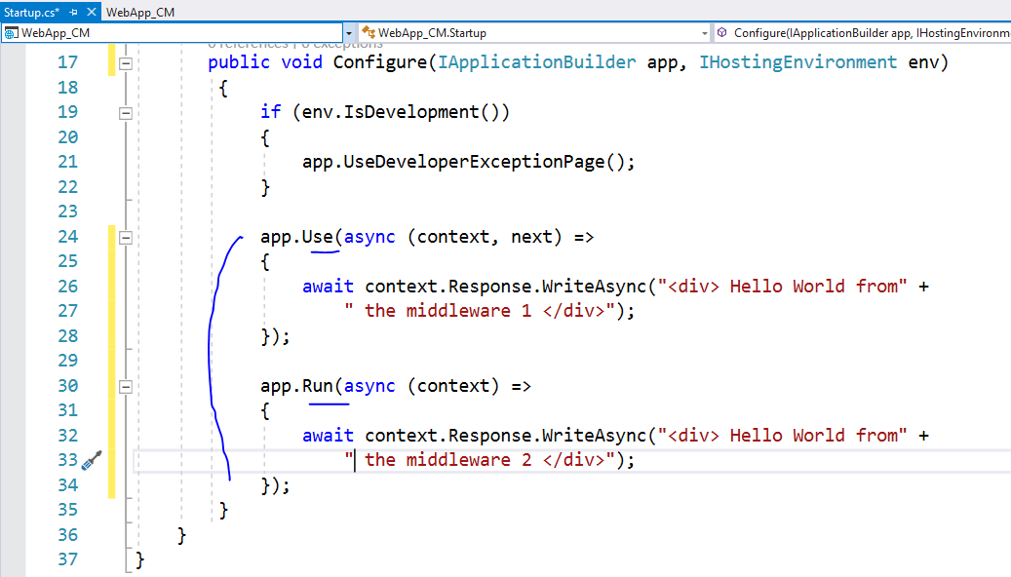

Slide 11
The app.Use gets two arguments. One is HttpContext and the second one is a RequestDelegate, which is basically the reference to the next middleware.
Now, run the code again.
The message “Hello world from the middleware 1” appears on the browser. The message from the second middleware does not appear
That is because it is the responsibility of the middleware to invoke the next middleware
We can invoke the next middleware by calling the invoke method of the next middleware, reference to which given to us in the constructor.
Now let’s modify the code to do that

Slide 12
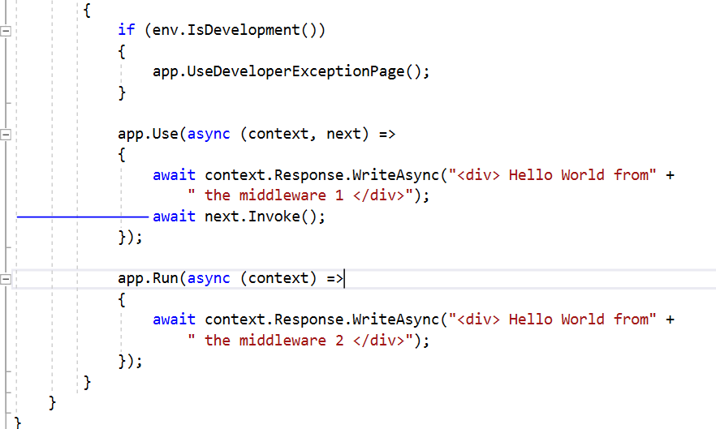
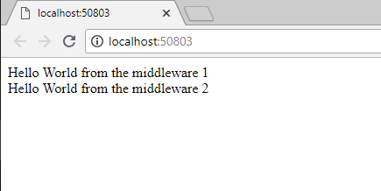

Slide 13
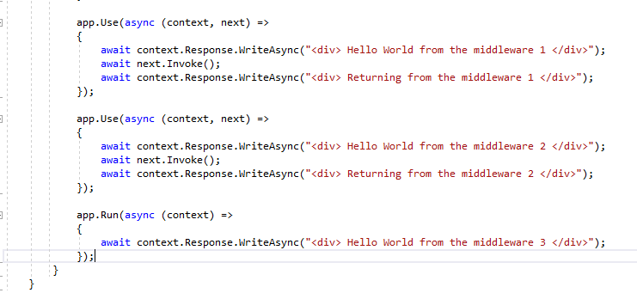
Now, let us add one more middleware and add a message after invoking the next middleware

Slide 14
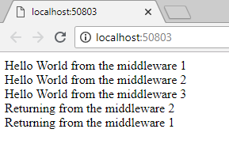
You will notice that Middlewares gets a second chance to look at the Request on the way back

Slide 15
Order Matters
Middleware is executed in the same order in which they are added in the pipeline.

Slide 16
Custom Middleware
In the above section, we created inline middlewares using the app.Use and the app.Run
The other way of creating the Middleware is by using classes.
The middleware class is not required to implement any interface or inherit from any class. However, there are two specific rules that you must follow.
1. The middleware class must declare a non-static public constructor with at least one parameter of type RequestDelegate
What actually you get here is the reference to the next middleware in the pipeline. When you invoke this RequestDelegate you are actually invoking the next middleware in the pipeline
2. The middleware class must define a public method named Invoke that takes an HttpContext and returns a Task.This is the method that gets invoked when the request arrives at the middleware

Slide 17
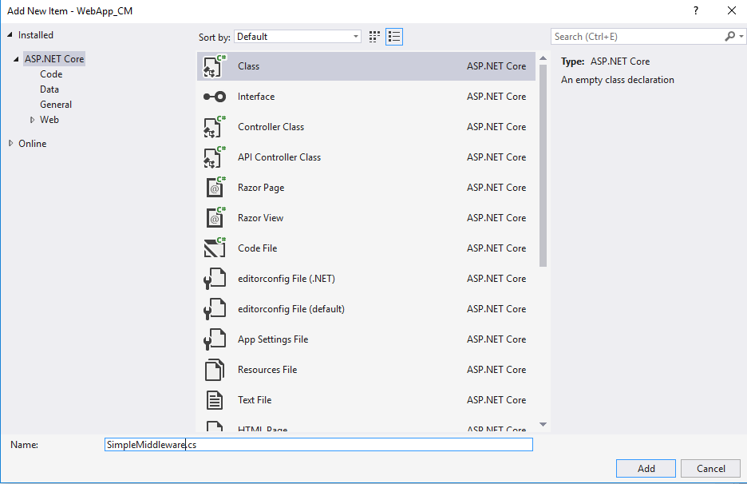

Slide 18
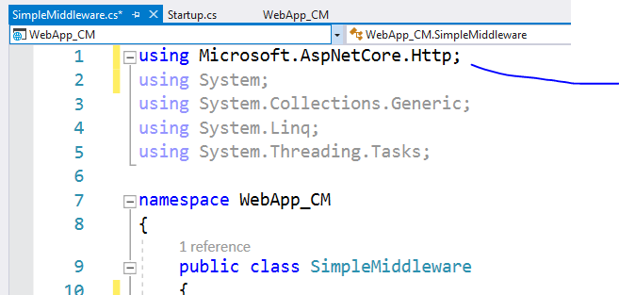

Slide 19
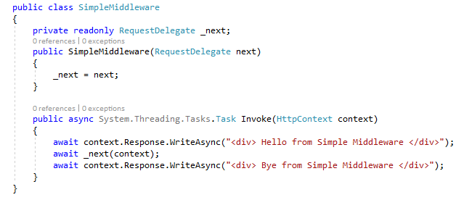

Slide 20
First, in the constructor, we will get the reference to the next middleware in the pipeline. We store it in local variable _next
Next, we must declare an Invoke method, which gets the reference to the HttpContext.
We write out some message to the response and then invoke the next Middleware using await _next(context) Passing it the HttpContext.

Slide 21
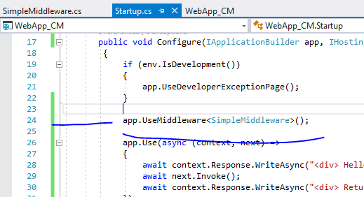
Next, we need to register the middleware in the request pipeline.
We can do that using the UseMiddleware method of the app as shown below

Slide 22
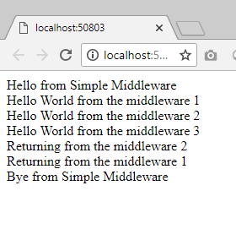

Slide 23
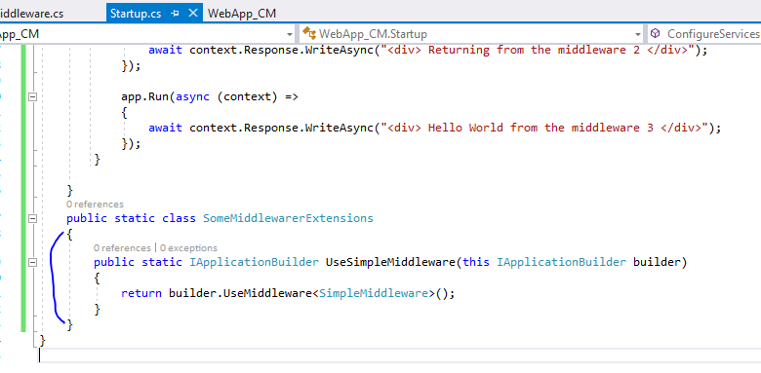
Extension method
We can create an extension method to simplify the registration of Middleware

Slide 24
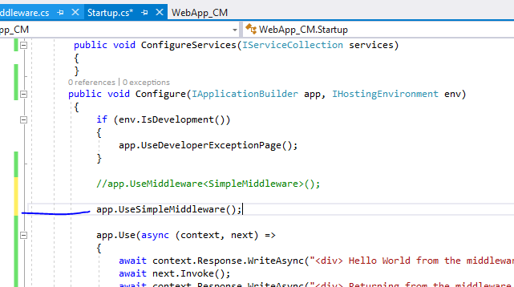

Slide 25
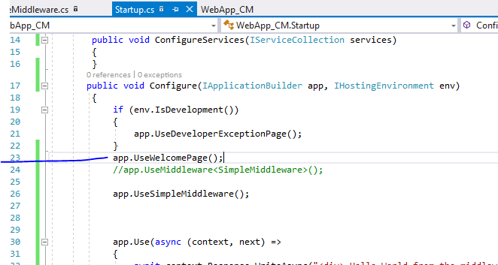
Same way there are many pre defined extension
Methods which are provided for us

Slide 26
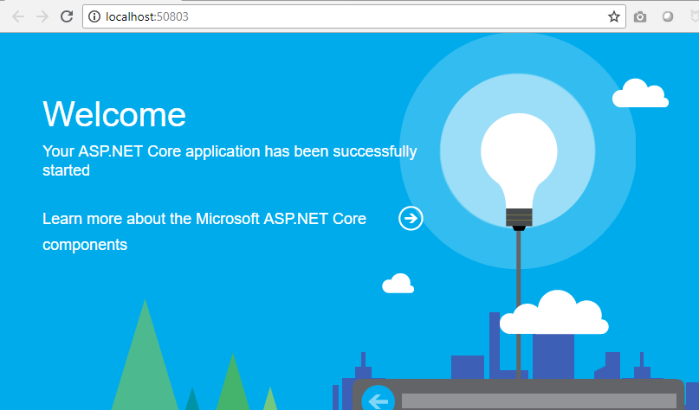

Slide 27
Conclusion:
The Middleware is software code, which processes the incoming requests. These Middlewares are chained together to form a request pipeline. We create Middleware and register in the configure method of the startup class

Slide 28
After Use and Run now it’s a time to learn Map

Slide 29
Map extensions are used as a convention for branching the pipeline. Map* branches the request pipeline based on matches of the given request path.
If the request path starts with the given path, the branch is executed.

Slide 30
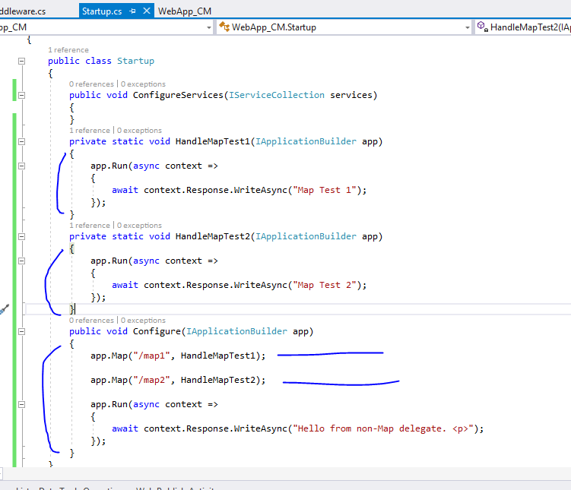

Slide 31
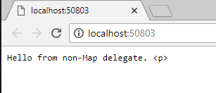
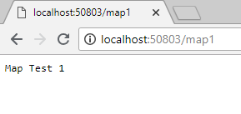
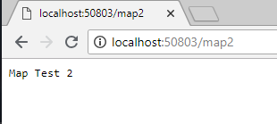
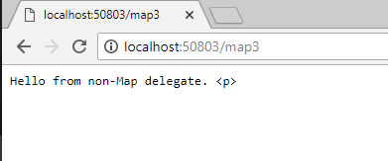

Slide 32
MapWhen branches the request pipeline based on the result of the given predicate.
Any predicate of type Func<HttpContext, bool> can be used to map requests to a new branch of the pipeline.
In the following example, a predicate is used to detect the presence of a query string variable branch:

Slide 33
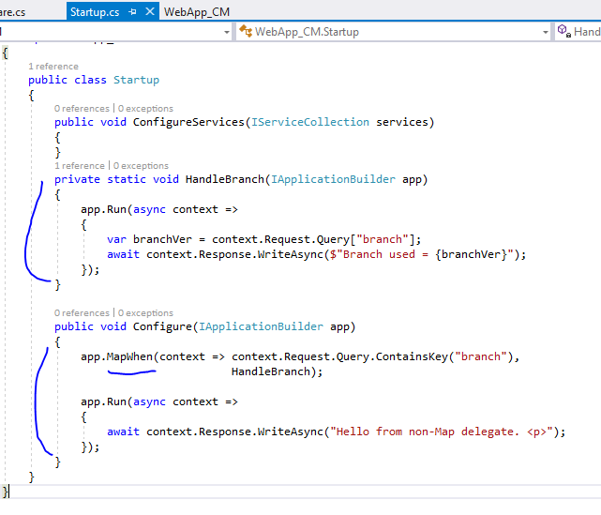

Slide 34
